Slide 1
Energy Pricing & Supply Update
July 2022​
Notes:
Expansiveness of community

Slide 2
Agenda Overview
The components that make up your bill and the difference between delivery and supply.
Current energy markets and global factors contributing to rising costs.
An overview of expected energy supply costs for the remainder of 2022.
Flexible payment plans available to help you catch up on your bill.
Energy efficiency programs, tips and resources that can help you manage your business’s energy use and lower your costs.
2

Slide 3
Understanding Your Electric Bill
3

Slide 4
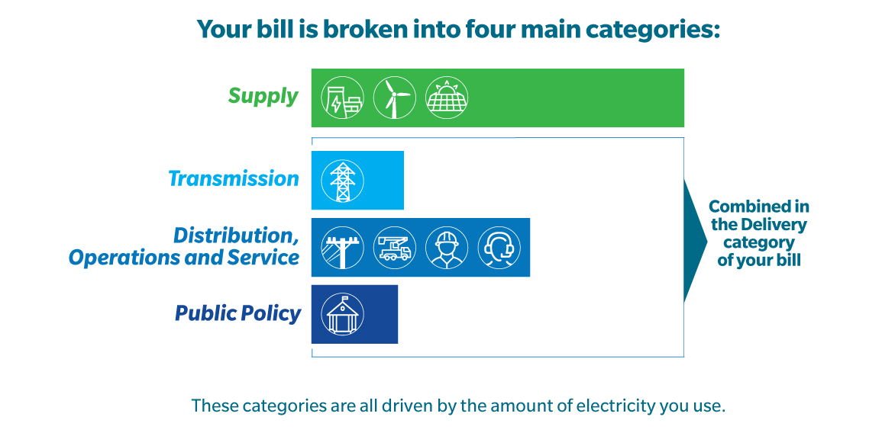
Understanding Your Electric Bill
4
Notes:
Energy bills are confusing. We get that, and we’re working hard to try to simplify this information for our customers. There are several line items in your bill, but they really fall into four main categories:
Supply
Transmission
Distribution, Operations and Service
And public policy.
Three of those categories – Transmission, Distribution and Public Policy – are all grouped together in the “Delivery” category on your bill.
To make it easier to see what you’re paying for each month, let’s break down what these categories really are.

Slide 5
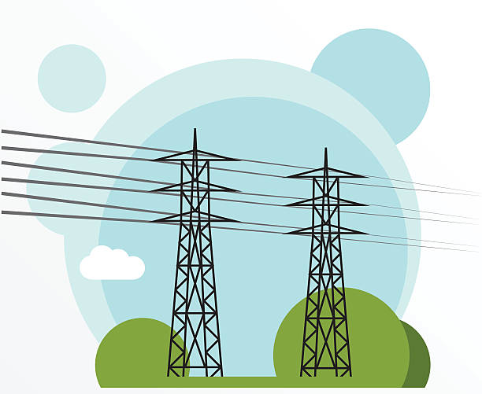
Understanding Your Electric Bill
Energy Supply:
The cost of the energy Eversource or a third-party supplier purchases for you.
This is a pass-through cost to customers with no profit to Eversource.
Transmission:
The cost of building, maintaining and operating the regional transmission system.
These charges are federally regulated by the Federal Energy Regulatory Commission (FERC).
5

Slide 6
Understanding Your Electric Bill
Distribution, Operations and Service:
Eversource’s core business – safely and reliably delivering power. This includes:
The cost of skilled employees that operate and maintain the local system of poles and wires
Customer service
Improvements to make the grid more resilient and reliable
Unlike a charge for delivery of a package, the delivery charges on your energy bill are driven by how much energy you use.
6

Slide 7
Understanding Your Electric Bill
Public Policy:
Includes costs mandated by the state and federal government for:
Financial assistance programs
Energy efficiency programs
Purchasing renewable and carbon-free electricity
Funding solar and electric vehicle incentives
You are contributing to these programs through your bill, so we encourage you to take advantage of everything that’s available to you.
7

Slide 8
Energy Service Rates
8

Slide 9
Energy Service Rates
Background
Procurement Process
New England Energy Mix
Natural Gas and Electric Energy Prices
New Energy Service Rates
9

Slide 10
Background
Customers have a choice in New Hampshire as to who provides their generation service.
Choices are:
Retail generation service providers
Eversource
For Eversource in New Hampshire, Energy Service is provided to retail customers who are not taking service from a competitor supplier.
Energy Service is currently provided to approximately:
85% of residential customers
30% of commercial customers
Under 10% of industrial customers
In aggregate, it represents about 50% of Eversource’s total distribution load
10

Slide 11
Procurement Process for Eversource
Eversource in New Hampshire does not own generation.
Accordingly, Eversource needs to procure its generation service from the New England market.
The New Hampshire Public Utilities Commission (NHPUC) requires Eversource to request bids from generation service suppliers.
These suppliers have the responsibility to serve the load of customers who have not chosen a retail supplier.
The NHPUC process is as follows:
Eversource changes its Energy Service rates on February 1 and August 1 of each year.
Eversource selects the lowest bid prices that are received on bid receipt day.
The NHPUC needs to approve all Energy Service rate adjustments.
Eversource receives no compensation for providing this service.
11

Slide 12
New England Annual Electric Energy Mix
50% natural gas used primarily by combined cycle generation
25% nuclear - Millstone in Connecticut and Seabrook in New Hampshire
15% imports from Canada and New York
10% renewable generation
12

Slide 13
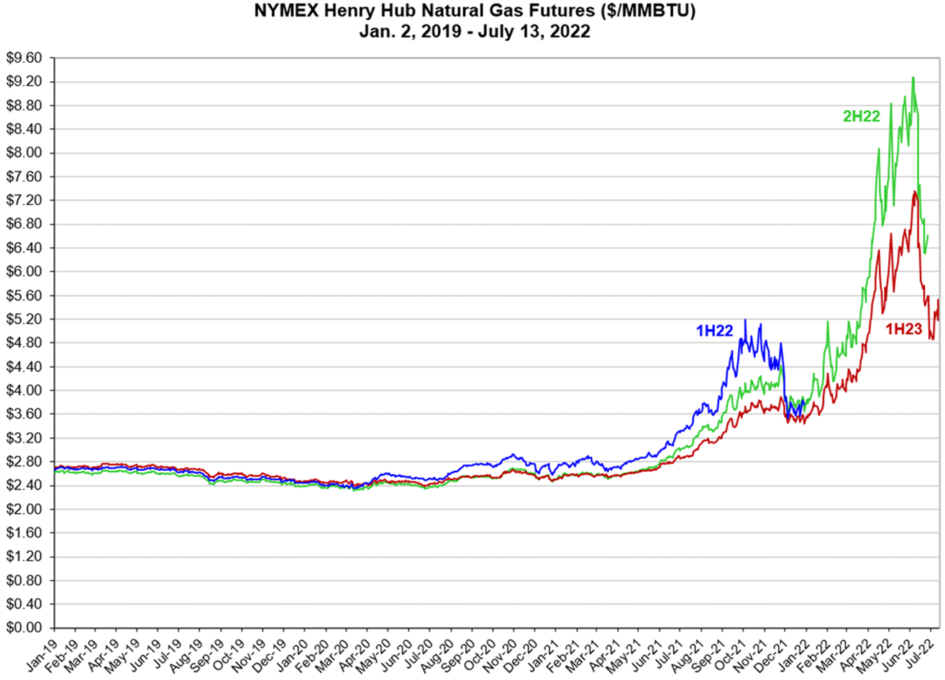
Natural Gas Prices
13

Slide 14
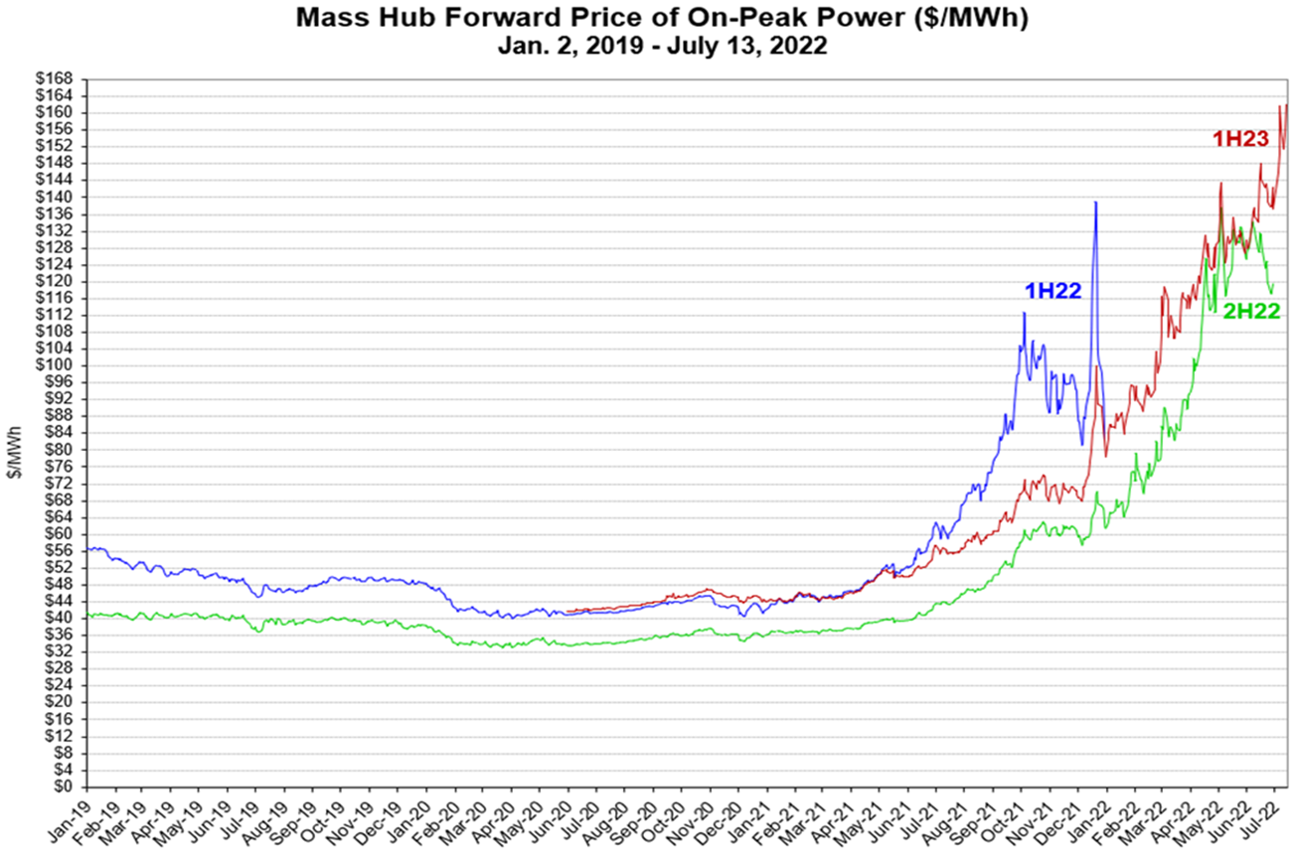
New England Electric Energy Prices
14

Slide 15
Observations
Natural gas prices drive electric energy prices in New England.
Since the beginning of 2022, natural gas prices have more than doubled, as have electric energy prices.
The Russia/Ukraine war is the primary driver of natural gas prices.
World supply has been disrupted by reduced natural gas exports from Russia to Europe.
The loss of Russia’s natural gas supply is being replaced with liquefied natural gas from the United States.
There are no near-term remedies for increasing natural gas supply becoming available.
15

Slide 16
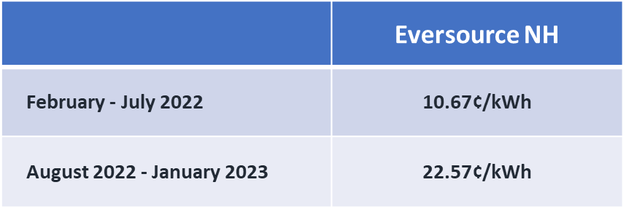
Energy Service Rates for Small Business Customers
Small customers = Rates R (Residential), G (General Service for customers whose demand does not exceed 100 kilowatts (kW), and OL (Outdoor Lighting).
16

Slide 17
Flexible Payment Program
17

Slide 18
A Flexible Payment Plan to Help Our Business Customers
We offer a 6 months payment arrangement.
No fees or interest charged while on the payment arrangement.
Protected from disconnection while making the required payments
20% down payment is due at arrangement setup
Next payment will be due 30 days from the arrangement setup
Call Us at 844-273-7760
18
Notes:
BAU - 1/3 down payment is due at arrangement setup

Slide 19
How Does the Plan Work?
Divides balance by the number of months requested (up to 6)
Distributes past due balance over the span of the plan
Amount due each month is more manageable
Let’s work together to find a solution that best meets your needs.
Call Us at 844-273-7760
19

Slide 20
We’re Ready to Help
Supplier List
energy.nh.gov/consumers/choosing-energy-supplier
NHsaves.com
Energy Efficiency Resources & Energy Assessments
866-554-6025
Business Call Center
844-273-7760
Payment Arrangements
20

Slide 21
Energy Efficiency Opportunities
21

Slide 22
Opportunities
Refrigeration equipment with controls keep your food fresher for longer while also reducing operating costs.
LED lights and lighting controls provide the right light level for the task, allow you to adjust for natural light through windows, require less maintenance, and help you save.
We can look at any measure that will save electricity cost-effectively.
22

Slide 23
Energy Efficiency Services
Education to help you understand your energy use
Incentives and Financing for balance of the selected measures
Ease of Use with a turnkey approach and qualified contractors
23

Slide 24
Do More. Save More.
24

Slide 25
Signing Up is Easy
Schedule a time to connect with an Eversource energy expert via phone
During your initial assessment, we’ll identify energy-saving opportunities and answer any questions
We'll schedule an in-person audit when you're ready. Afterwards, you’ll get a detailed report of all the ways you can save your business money and energy
25

Slide 26
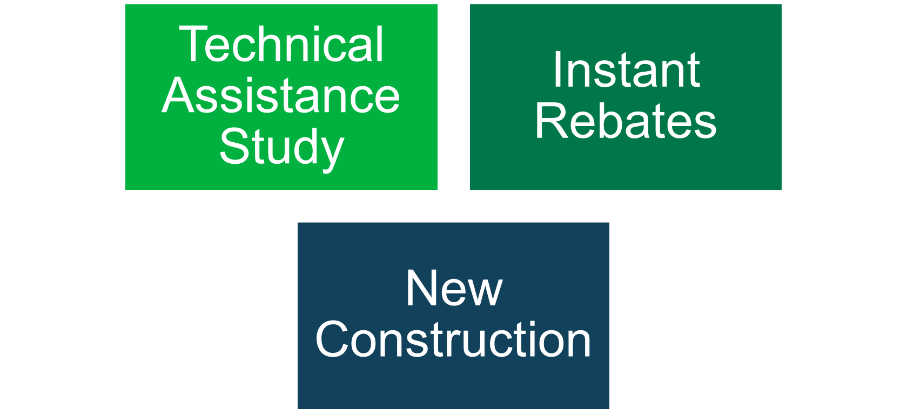
Go Beyond Retrofits
26

Slide 27
How to Apply
Contact us at
866-554-6025
efficiencynh@Eversource.com
NHSaves.com
27

Slide 28
Personalized Customer Support
We work one-on-one with customers to guide them to the payment plan or program that best meets their needs.
We offer special programs to lower monthly bills, reduce past due balances and protect from disconnection.
Energy efficiency programs help customers save money on their bill and manage energy use. No-cost services are available to eligible customers.
We encourage all customers to call us or visit Eversource.com/billhelp for more information about resources to assist with their utility bill.
28

