Slide 1
Town of Newbury
Community Power
With Standard Power
October 5, 2023

Slide 2
Community Power
RSA 53 E:1
Provide access to competitive markets for supplies of electricity and related energy services
Provide small customers similar opportunities to those available to larger customers, in obtaining lower electric costs, reliable service, and secure energy supplies
Encourage voluntary, cost effective and innovative solutions to local needs with careful consideration of local conditions and opportunities
Purpose

Slide 3
What is Community Power?
Municipality procures electricity supply for residents and small businesses but does not take ownership of the power
Eversource continues to provide all delivery, emergency, and billing services including the same work crews
*Stable competitive rates, consumer protections, attractive program choices, and the impact of a Green Program Default

Slide 4
Secure Competitive Pricing
Market Timing
Buying Power
Contract Length
+
+

Slide 5
Use and Support Local
Renewable Energy
Renewable Energy Markets
Program Choices
Local Resource Development
Notes:
Add Market slide (check theme)

Slide 6
More Benefits
Local control
Consumer protections
Energy planning
Innovative local programs
Education and awareness

Slide 7
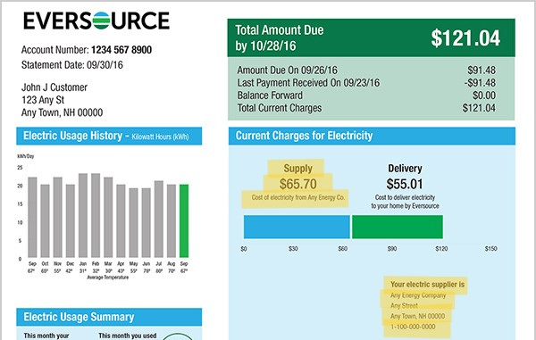
Utility Bill
*Newbury Community Power is used as supplier name for Standard Power programs.

Slide 8
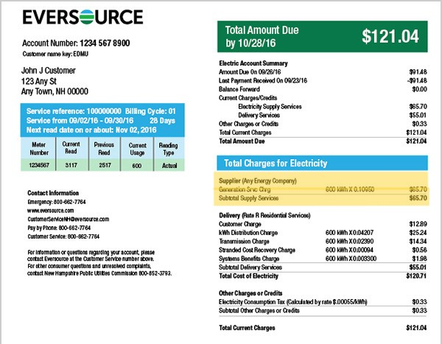
Utility Bill
*Newbury Community Power is used as supplier name for Standard Power programs.

Slide 9
New default supply service and more choices
Utility Default Service Customers
Third Party Offers
Community Power Program Default Service*
Basic product (optional)
50% renewable(optional)
100% renewable (optional)
*Eligible customers are automatically enrolled in program default unless they opt out.
Other customers can opt into the program.

Slide 10
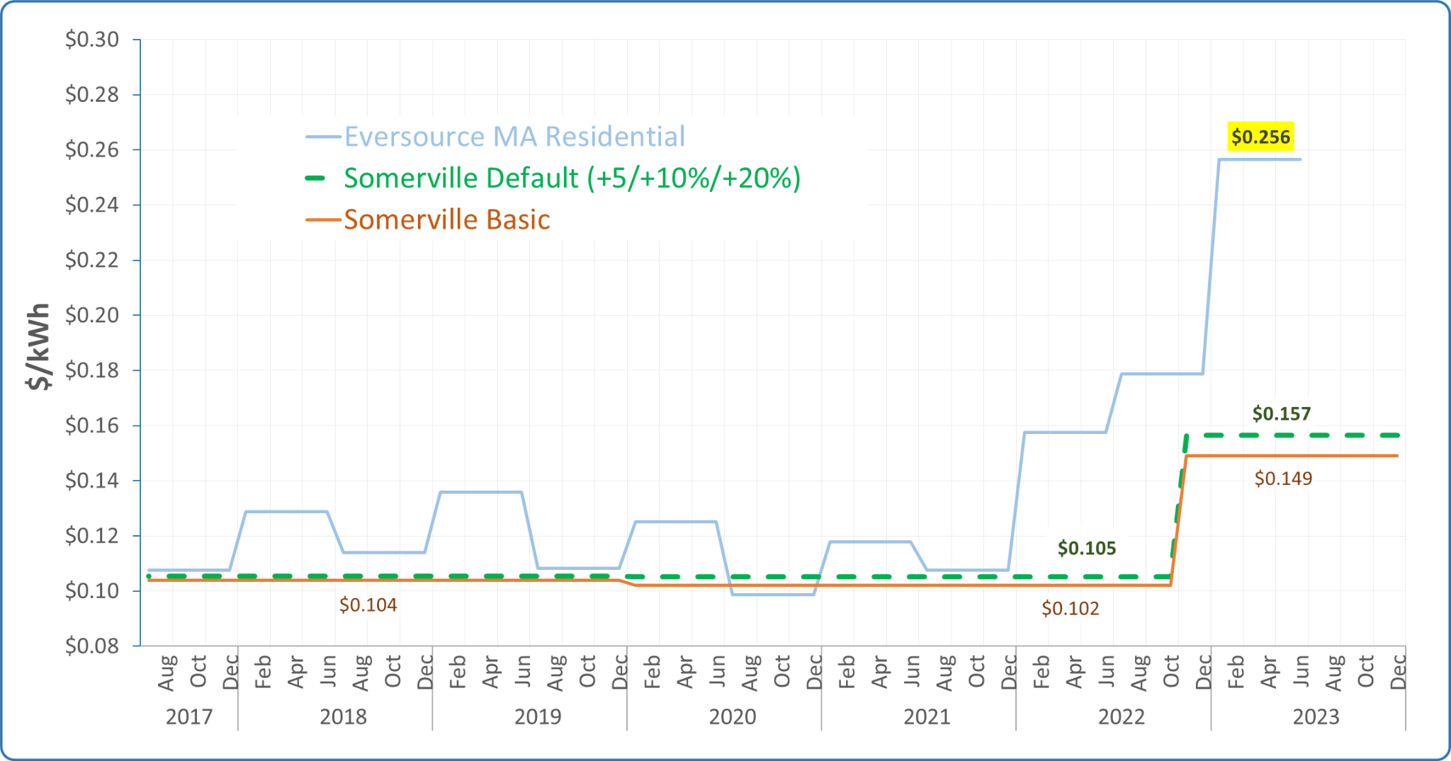
Example: Somerville Community Choice
Disclaimer: Savings cannot be guaranteed, because utility Basic Service prices change every six months for residential customers
Notes:
New Eversource MA rate is 15.899 cents/kWh July 1 2023 to Jan 1 2023.

Slide 11
Community Power
Rate relief for customers upon program launch
Stable rates preferred by customers
level monthly costs
allow for planning, budgeting and evaluating investments
plan expenses out further than the duration of the utility default rate of six months
Long-term savings on electric bills is the goal, through program design, implementation and evolution
No individual customer contracts or exit fees
Consumer protections
Program
Goals

Slide 12
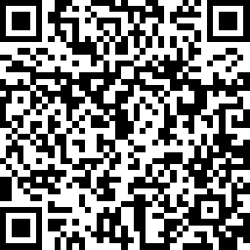
31 Respondents
30 homes and 1 businesses
19% have solar panels
Email and Town Website/Facebook are the best method for program reach out
97% have done something at home for energy efficiency
Newbury
Community Survey
Take the survey today!
Standard Power of America, 17 Technology Way, Nashua NH 03060 https://standardpower.com/

Slide 13
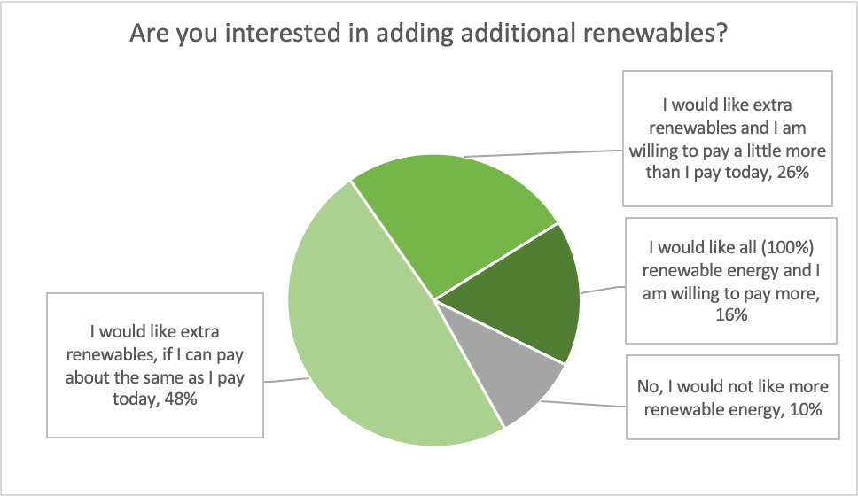
Newbury
Community Survey
Standard Power of America, 17 Technology Way, Nashua NH 03060 https://standardpower.com/

Slide 14
Newbury Community Power
 | Automatic Enrollment
Basic | Newbury Default | Newbury 50% | Newbury 100%
Lowest Rate | Competitive Rate | Small Increase | Market Rate
Meets state minimum requirements | Target 5-10% additional renewable energy | Targets 50% renewable energy | Targets 100% renewable
Program Options

Slide 15
Timeline
First Steps
Plan & Approve
Regulatory
Outreach + Launch
Manage + Monitor
Appoint a Community Power Committee
Choose Standard Power to help plan and launch your program
Draft Community Power Plan with public input
Submit Plan to Public Utilities Commission for approval
Town vote 2024 approval of Community Power
Procure electricity supply
Implement public education and opt-out campaign
Launch! Eligible accounts that have not opted out are automatically enrolled
Provide ongoing customer support, outreach, opt up campaigns, data management and analysis, planning, and more

Slide 16
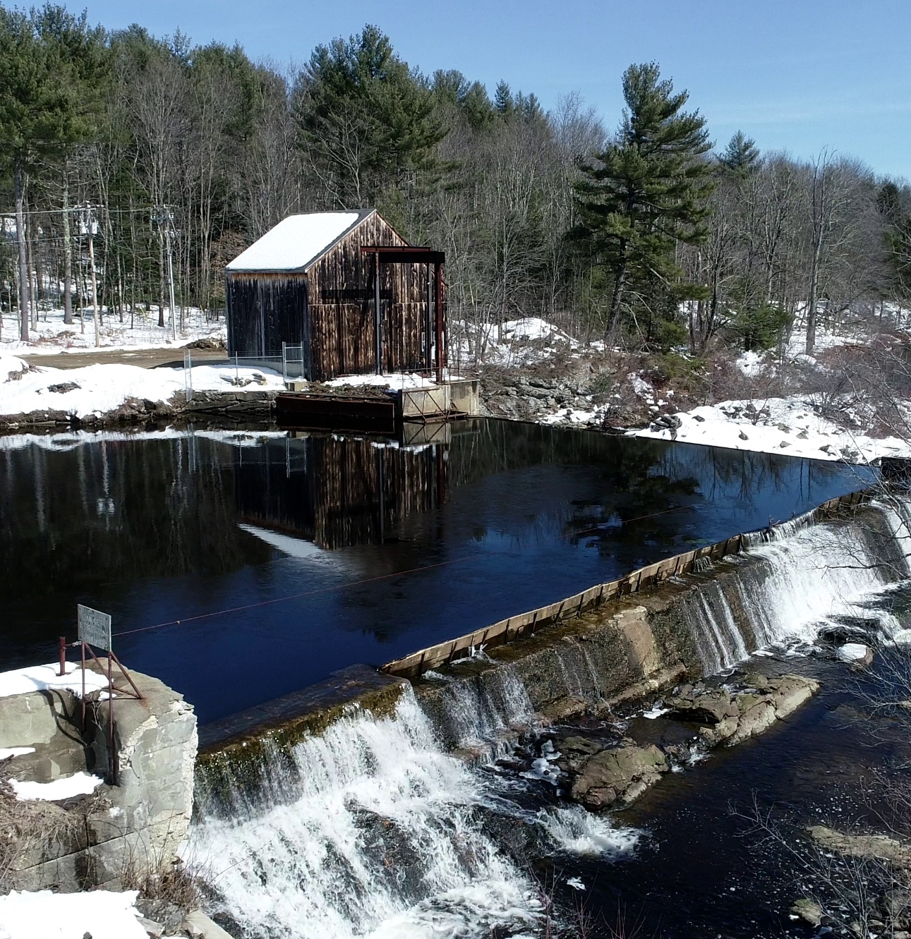
NH Energy Broker and services provider since 2010
Largest Group Net Metering program in NH
Complete Community Power services for 24 NH communities
First four programs launched in June including Keene
Standard Power of America, 17 Technology Way, Nashua NH 03060 https://standardpower.com/
Standard Power was founded in 2010

Slide 17
Meet our Dedicated Team!
Bob
Hayden
Emily
Manns
Theresa
MacDowell
Ryan
Polson
Contact us:
b.hayden@standardpower.com
e.manns@standardpower.com
t.macdowell@standardpower.com
StandardPower.com
John
Delsignore
Mel
Almasian
Devon
Atwell
Morgan
Williams

